Slide 1
(Some) Contributions of NLP to Clinical Informatics
Guy Divita
VA HSRD Field Based Meeting Sept 15, 2016

Slide 2
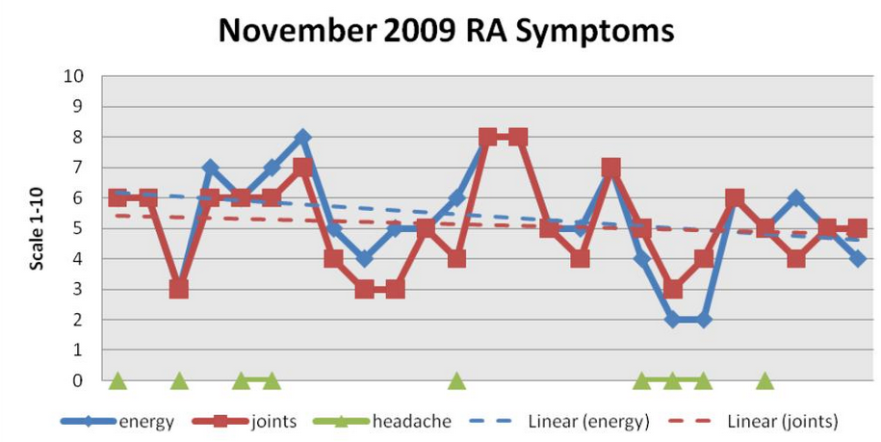
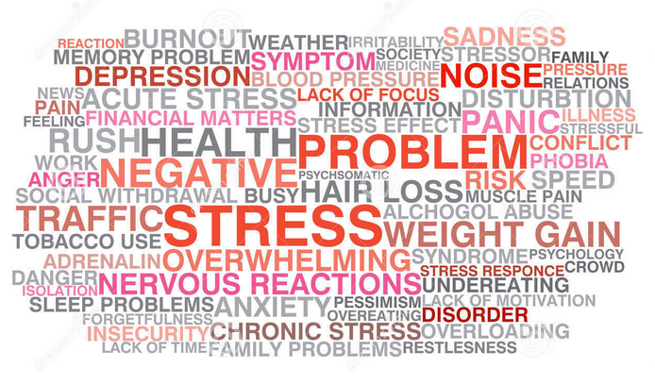
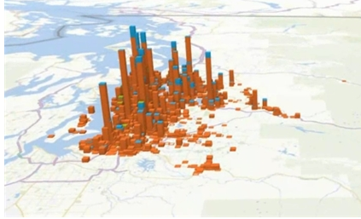
Introduction
Substantial amounts of Clinically significant information ONLY contained in the unstructured medical notes or under reported
Goal: Transform relevant instances found in notes into discrete data

Slide 3
Use Case
Challenges
Use Case
Feature extraction from clinical notes
Epidemiologic Studies
Bio-surveillance
VERY heterogeneous
Policy/ Utilization/ Compliance/
2+ Billion Records
Notes:
Here is the use case – we are tasked with doing feature extraction from VA clinical notes for
the purposes of
epidemiological studies
bio-surveillance
Policy
utilization
compliance
quality assertion
(click)
Within an environment that is Very heterogeneous
with billions of records

Slide 4
Concept Extraction Challenges
Semi structured text
Slot: Value pain scale: 7
Contextual Statements
About the patient brother had mi
History of h/o sob
Questions Have you had …
Fill in the blank Days sick ___
Hypothetical May experience
Conditional p.r.n. pain
Negation denies alcohol
Check boxes [ ] yes [ x ] no
2700 Types of Records
Nursing Notes
Surveys
Group Discussions
Notes:
Heterogeneous in the sense that these records are replete with semi-structured components including
slot: value structures – for example pain scale: 7
check boxes
questions and their answers
fill in the blank kinds of boiler plate
Where we have to worry about contextual environment including
whether the statement is about the patient or not,
whether the statement is about something in the past
whether the statement is conditional, for instance, take this for pain
and of course
negation
Where many studies include two or three document types like discharge summaries, and history and physicals,
the 2 billion plus records in this corpus have 2700 types of records including surveys, group discussions along the expected kinds of records
click
These are the demons that we deal with

Slide 5

Theme
Call on NLP when your eureka feature is not in structured data
Call on NLP when your eureka feature is under-reported in structured data

Slide 6
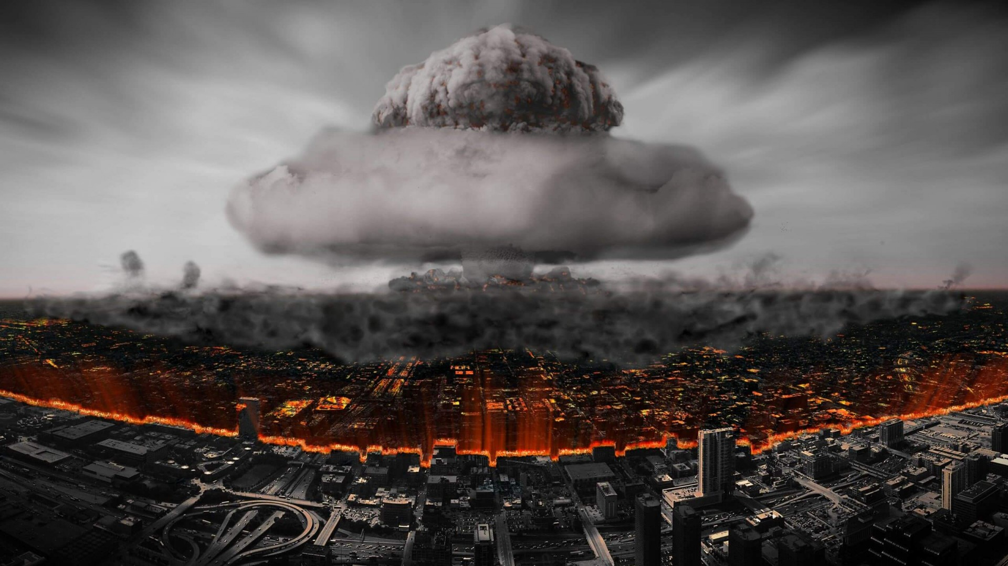
High Profile Projects
Predicting homelessness - under reported
General symptom extraction - under reported
Military Sexual Trauma (MST) - under reported
CAUTI - Not in structured text
Colonoscopy Quality QUERI - Not in structured text

Slide 7
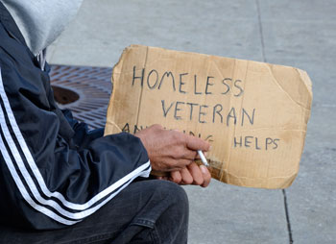
Using Psychosocial Risk factor Mentions in Clinical Notes to Predict Homelessness
Why
High priority within the VA
Risk factors underreported and not well documented in EMR
Work Done
Dictionary Based Extraction
Based on field experts + literature search + UMLS Terminology
Published Efficacy tested PPV: .8 from a 350K stratified sample across document types where the homelessness status was known
10.5 Million document cohort processed for
Machine Learning model combined with structured data

Slide 8
Using Psychosocial Risk Factor Mentions in Clinical Notes to Predict Homelessness (2)
Lessons Learned
False Positives caused by templated text
Can and should limit to processing high yield document types

Slide 9
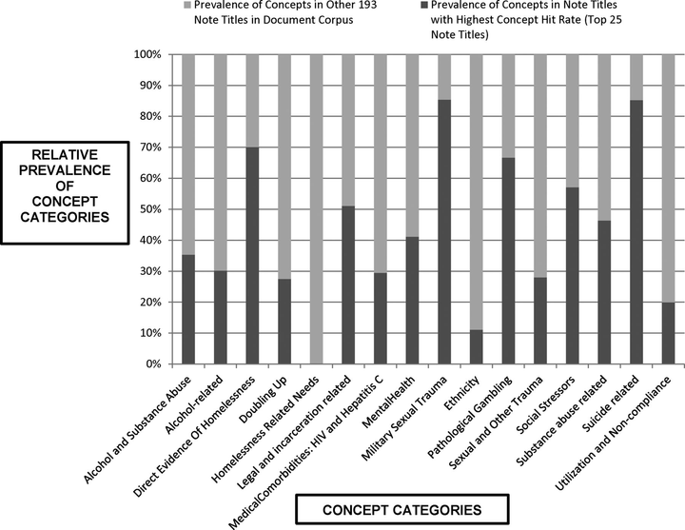
Homelessness (3)

Slide 10

Identifying General Symptoms within Clinical Notes using NLP
Why
Symptom identification is known to be underreported in EMR
Motivated by Medically Unexplained Syndrome task to identify clusters of common symptoms in OEF/OIF Veterans

Slide 11
Identifying General Symptoms within Clinical Notes using NLP (2)
Background
Symptom Terminology overlaps with a continuum of ambiguous terms including findings, diagnosis, diseases and syndromes.
Terminology not consistently classified in medical vocabularies (i.e. UMLS)
Pain not classified as symptom
Abnormal behavior not classified as symptom
Prior work using cTAKES + UMLS Symptom category reported to be f = .4

Slide 12
Identifying General Symptoms within Clinical Notes using NLP (3)
Work Done
Lexicon of 92,000 symptoms derived from UMLS using novel technique
Dictionary Lookup + Rules + Machine Learning using 62 features
Optimal Machine Learning algorithm derived from automated exhaustive permutations of weka algorithms and parameters
Efficacy benchmarked at F = .68, Recall =.69 Precision = .68
Symptoms Extracted from a 1 million record cohort of OEF/OIF patients
Example Rules:
Normal behavior + abnormal modifier = symptom : trouble walking
Anatomical location + action = symptom : stabbing in leg
Other Symptom triggers : feels, like, as if

Slide 13
Identifying General Symptoms within Clinical Notes using NLP (4)
Lessons Learned
Machine Learning needed to reduce FP’s. FP’s from ambiguous mentions, templates

Slide 14
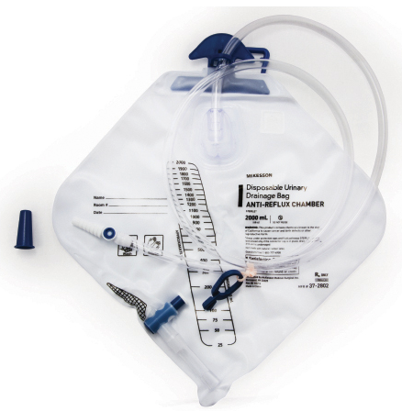
Identifying Patients with Catheter-Associated Urinary Tract Infections (CAUTI) using Clinical Notes
Why
VA hospitals want to reduce CAUTI rates
Can’t identify patients with urinary catheters from db
Urinary catheter mentions primarily in nurses notes
Work Done
Dictionary Lookup Extraction to identify patients with urinary catheters
Lexicon from prior art, vocabulary discovery around seed terminology usage in corpus
Published efficacy benchmarked: 98% PPV, 72% Recall
Machine learning model being developed with database fields on positively identified patients to detect infections and causes
Lessons Learned
Pertinent Negatives, negative evidence important

Slide 15
Identifying Patients Who Experienced Sexual Trauma From Clinical Texts
Why
Military Sexual Trauma identified as a priority in the Blueprint for Excellence
Under-reported in database but providers record patient experiences
Able to classify by childhood, adult, military
Preliminary Work
Dictionary based extraction
Initial terminology from experts in the field and prior art
Vocabulary discovery around seed terminology usage in large corpus
Templates identified and filtered out
Efficacy: Validating the technique now
Identified high yield documents from document types with the most mentions

Slide 16
Identifying Patients Who Experienced Sexual Trauma From Clinical Texts (2)
Cohort: 10,000 Male, 10,000 Female patients
362,359 Documents
5357 (1.4%) docs with asserted mentions
2,963 (0.8%) Documents with mentions from Patients w/ MST flag
2,394 (0.6%) Documents with mentions from Patients w/out MST flag
1609 Patients (8.0%) included w/ MST Flag
1544 (7.7%) patients with asserted mentions
624 (3.1%) Patients with mentions from patients w/ MST flag
920 (4.6%) Patients with mentions from patients w/out MST flag
Top 40 Standard Titles cover 55% Asserted Mentions

Slide 18
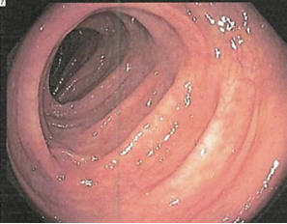
Colonoscopy Quality: Identifying Bowel Prep Quality from Clinical Texts
Why
VA provider adenoma discovery rates to be benchmarked
Bowel Prep quality is needed variable
Only contained in notes
Preliminary Work
Collaboration with other development groups
Dictionary + rule extraction tool created
1000 document hand annotated for training purposes
Proof-of-concept efficacy based on training data now in the high .90’s

Slide 19
Colonoscopy Quality: Bowel Prep Annotator: Classes, Anchors, Evidence
Bowel Preparation Class
Bowel Preparation = Bowel prep Anchor + Bowel Prep Evidence in a sentence
Bowel Preparation
Colon prep
was
good
Bowel Preparation Quality:
“good”
Bowel Prep Anchor Class
Preparation|prep
Visualization|visualized
Bowel Prep Evidence Class
good
Fair
Poor
Excellent
Adequate

Slide 20

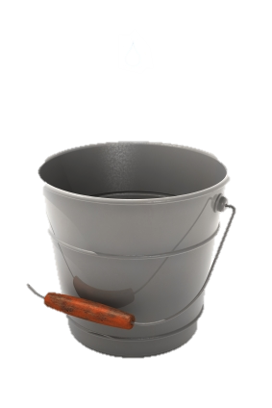
Other Examples
Suicide Prevention
Classifying Suicide Notes – John Pestian
Real-time Topic Models for Crisis Counseling – Karthnik Dinakar et al.
An automated online crisis dispatcher – Siska Fitrianie, Leon J.M. Rothkrantz
PTSD
Measuring Use of Evidence Based Psychotherapy for Posttraumatic Stress Disorder – Brian Shiner et al. (including Len D’Avolio)
Ejection Fraction
Jenifer Garvin, et al., S Pakhomov, et al.
Sentiment Analysis, Emotion Detection
Alternative Medicine

Slide 21
Conclusions
Call upon NLP when no or little structured data exists
Call upon Machine Learning when there are too many FPs
Word usage around seed terms in cohort adds useful terms
Account for Templates
Negative evidence is useful
High Impact NLP is being done

Slide 22
Acknowledgements, Disclaimers, Contacts
Funding for this project was provided by US Department of Veterans Affairs, Veterans Health Administration, Office of Research and Development, Health Services Research and Development Projects # HIR 10-001, HIR 10-002 , IIR 12-084-3, HX001145-02, QUERI 15-283
Resources and administrative support were provided by the VA Salt Lake City Health Care System (IDEAS Center)
Symptom Extraction PI: Matthew Samore
Homelessness, CAUTI, Sexual Trauma PI: Adi Gundlapalli
Colonoscopy Quality QUERI PI: Tonya Kaltenbach

